Slide 1
NPNL Power Oscillation Contest
Ben Bragg

Slide 2
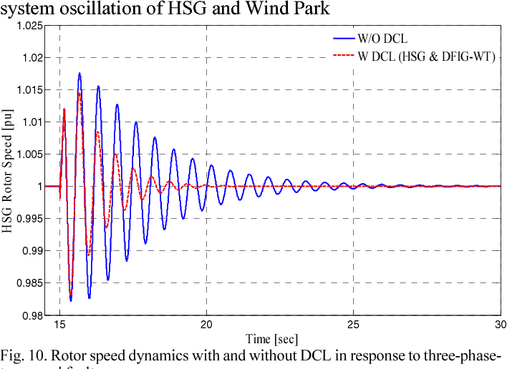
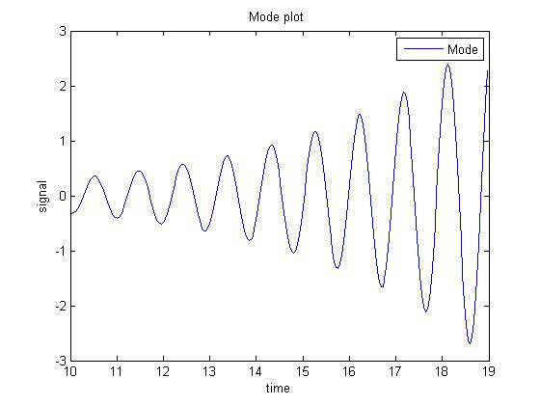
What is a Power Grid Oscillation?
Some oscillation is natural and fine.
Bad oscillations:
Low-frequency
Continuous
Growing
Can be caused by:
Load changes
Equipment going offline
Problematic equipment

Slide 3
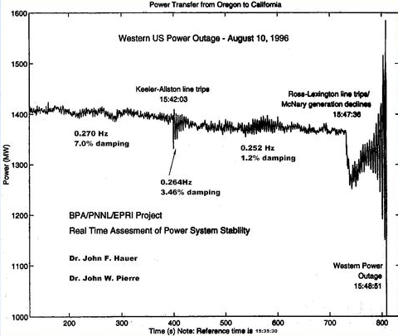
Why is it Important to Detect Them?
Can damage equipment and cause cascading blackouts
(See graphic to right: Western US Power Outage on August 10, 1996)
Early detection can identify where and what the problem is, allowing controllers to by-pass the issues and keep the power flowing.

Slide 4
The Contest
Hosted by PNNL
Goal: Locate source of oscillation
4 sets, 13 cases
Bus Voltage Angle
Bus Voltage Magnitude
Line Current Angle
Line Current Magnitude

Slide 5
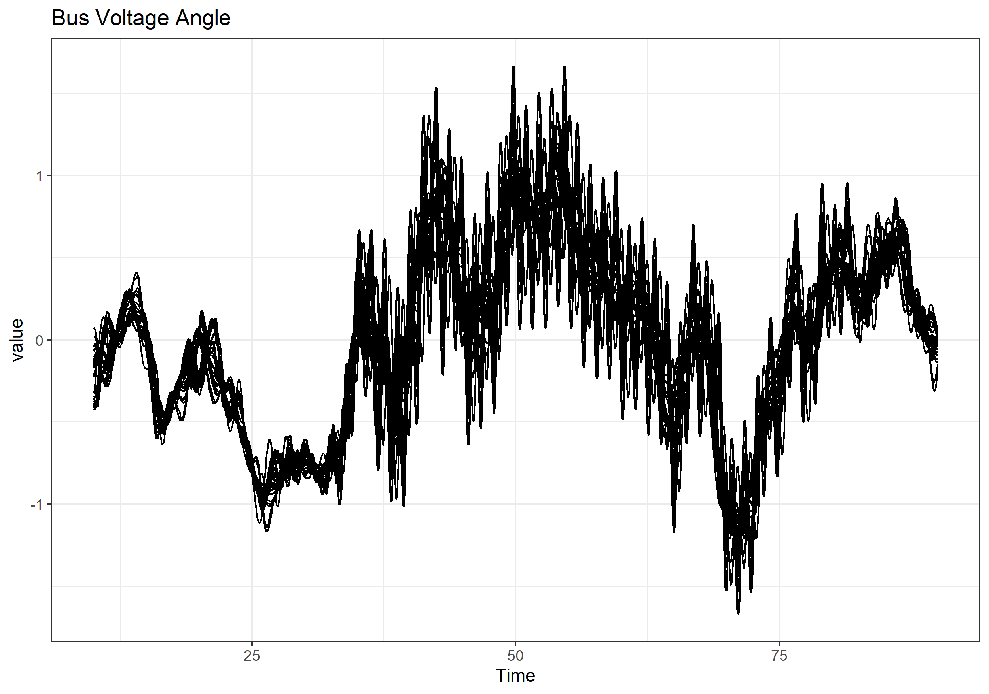
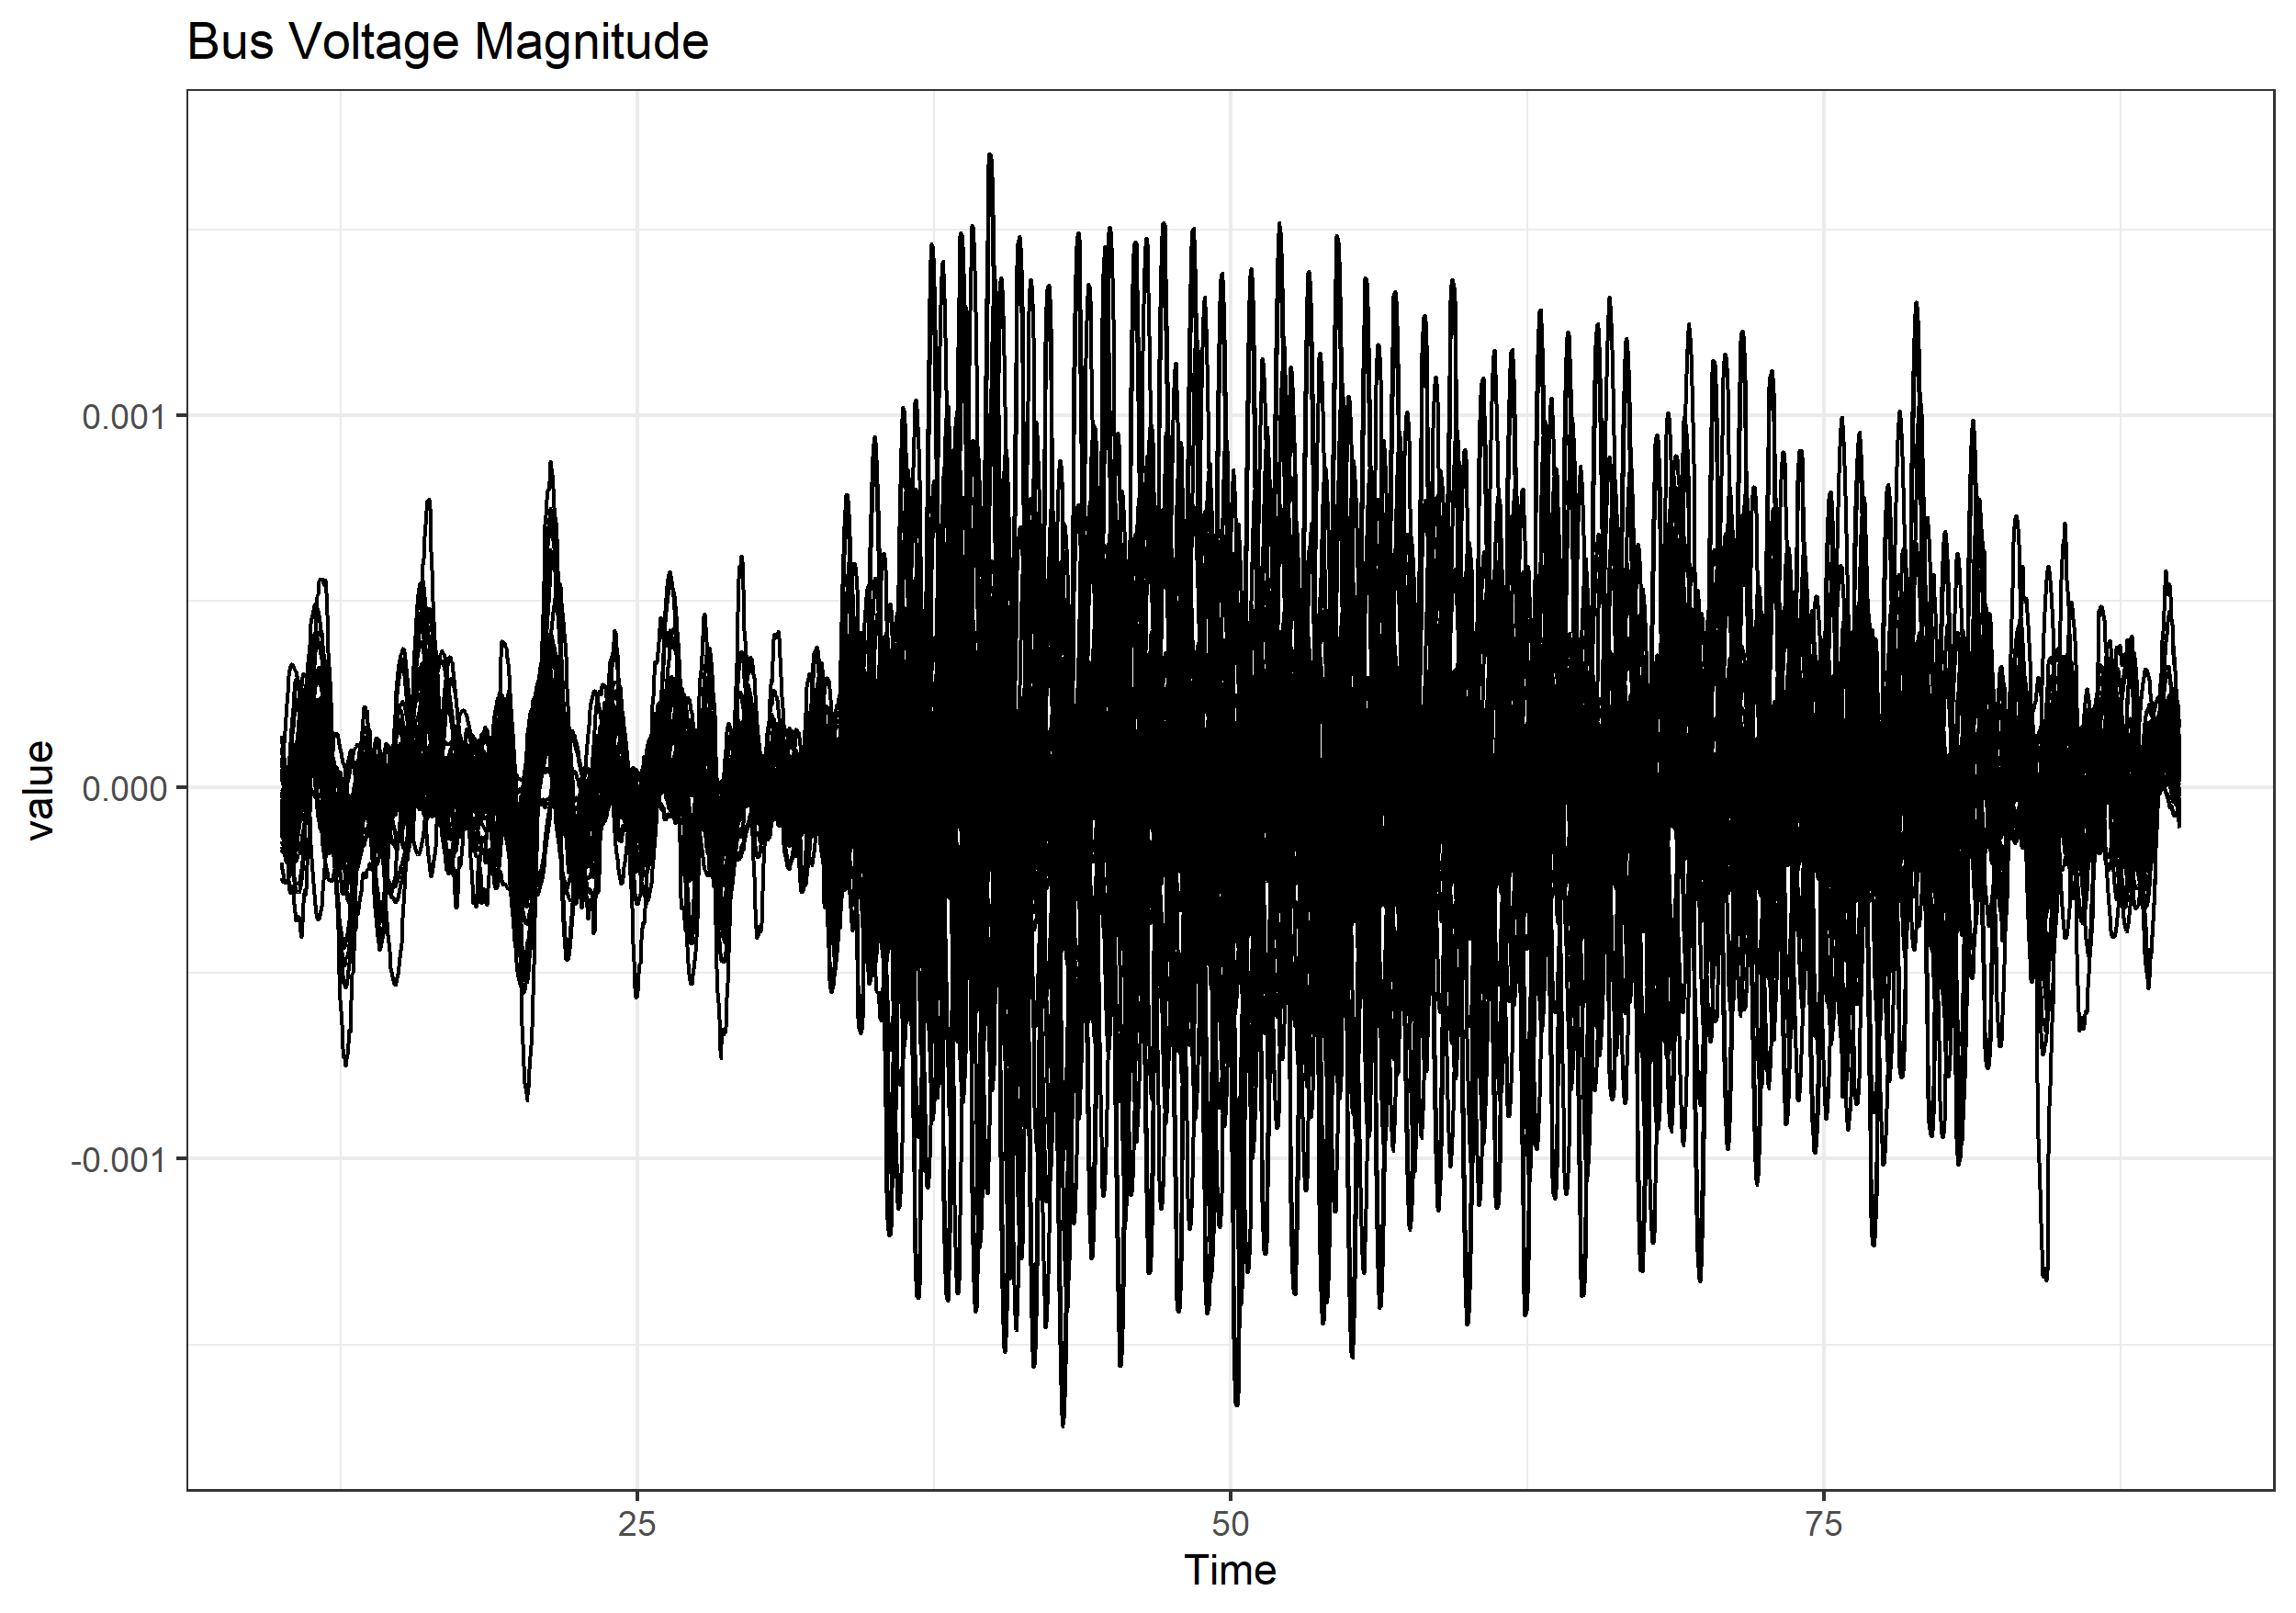
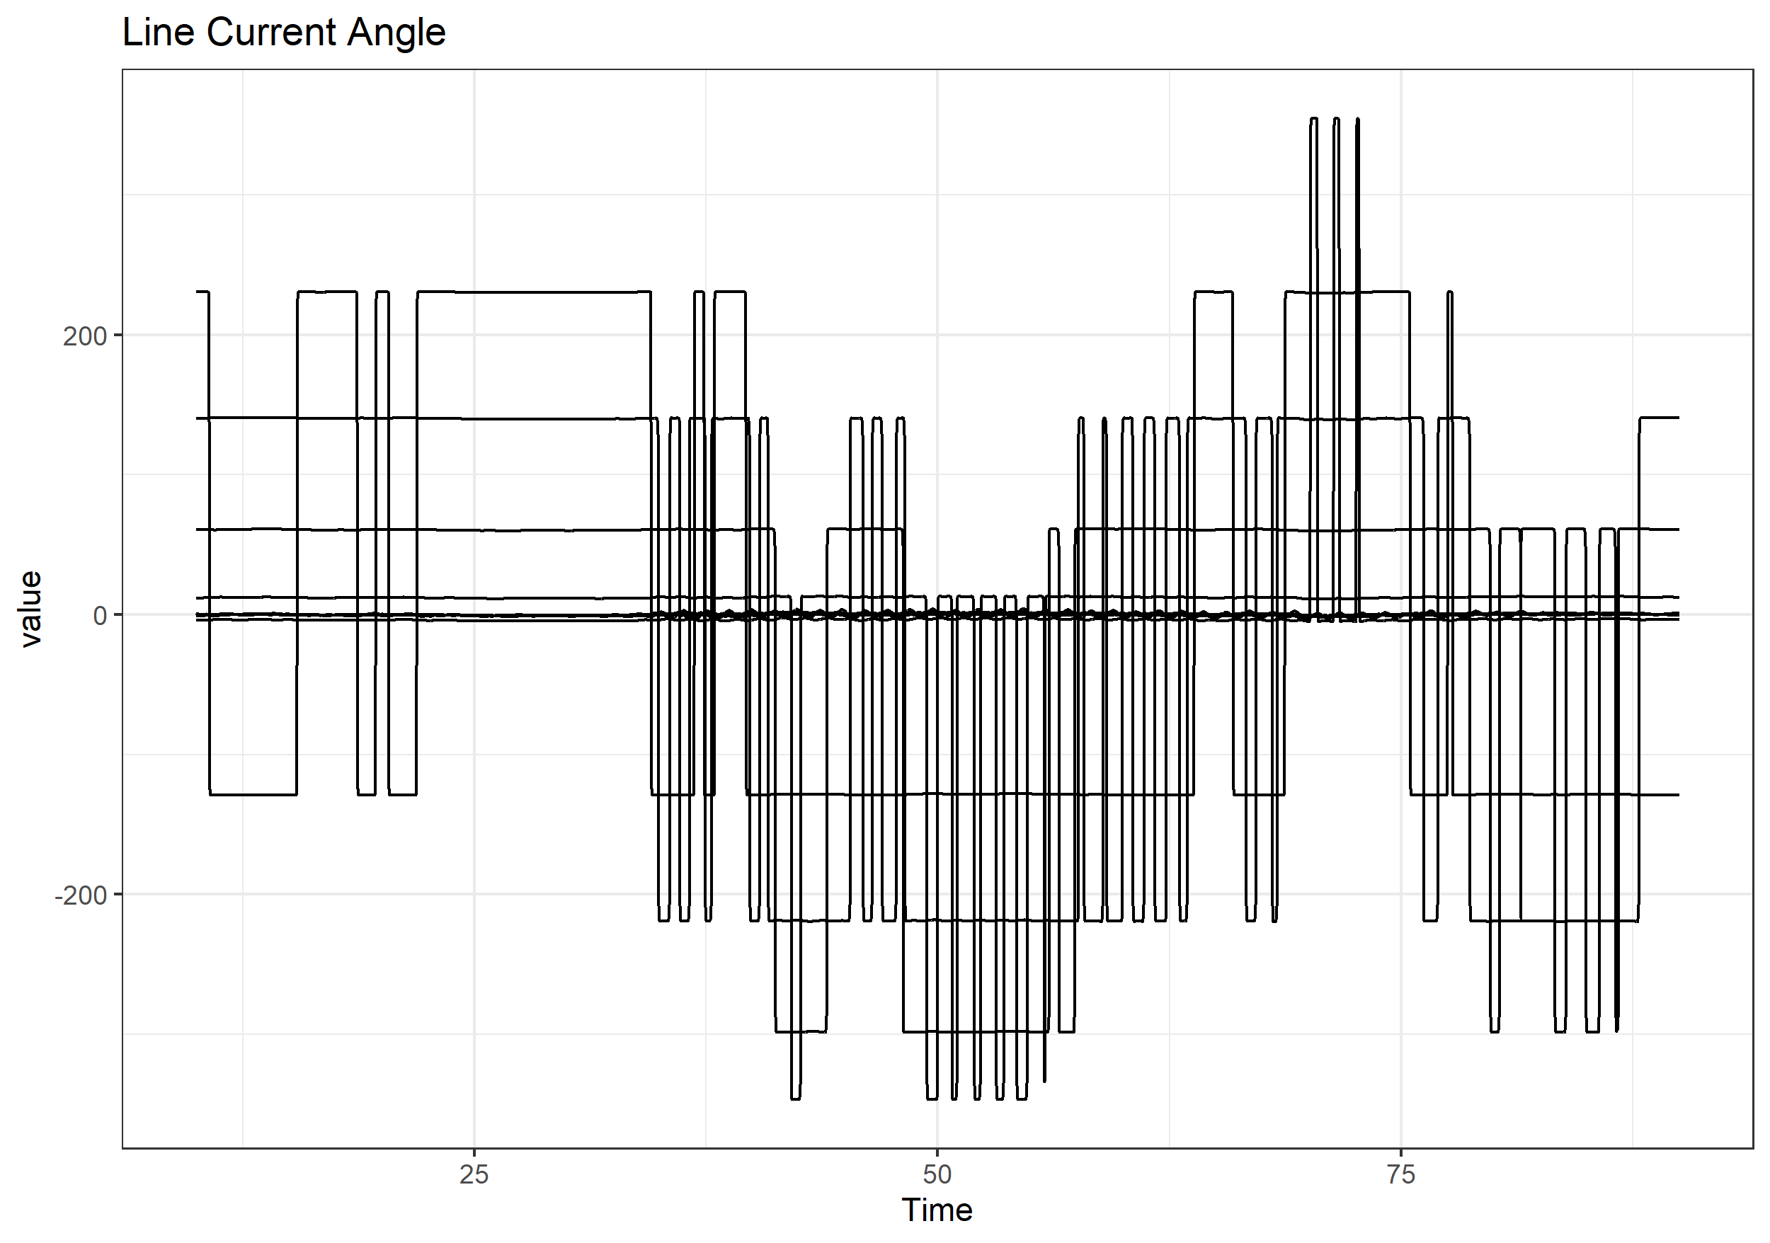
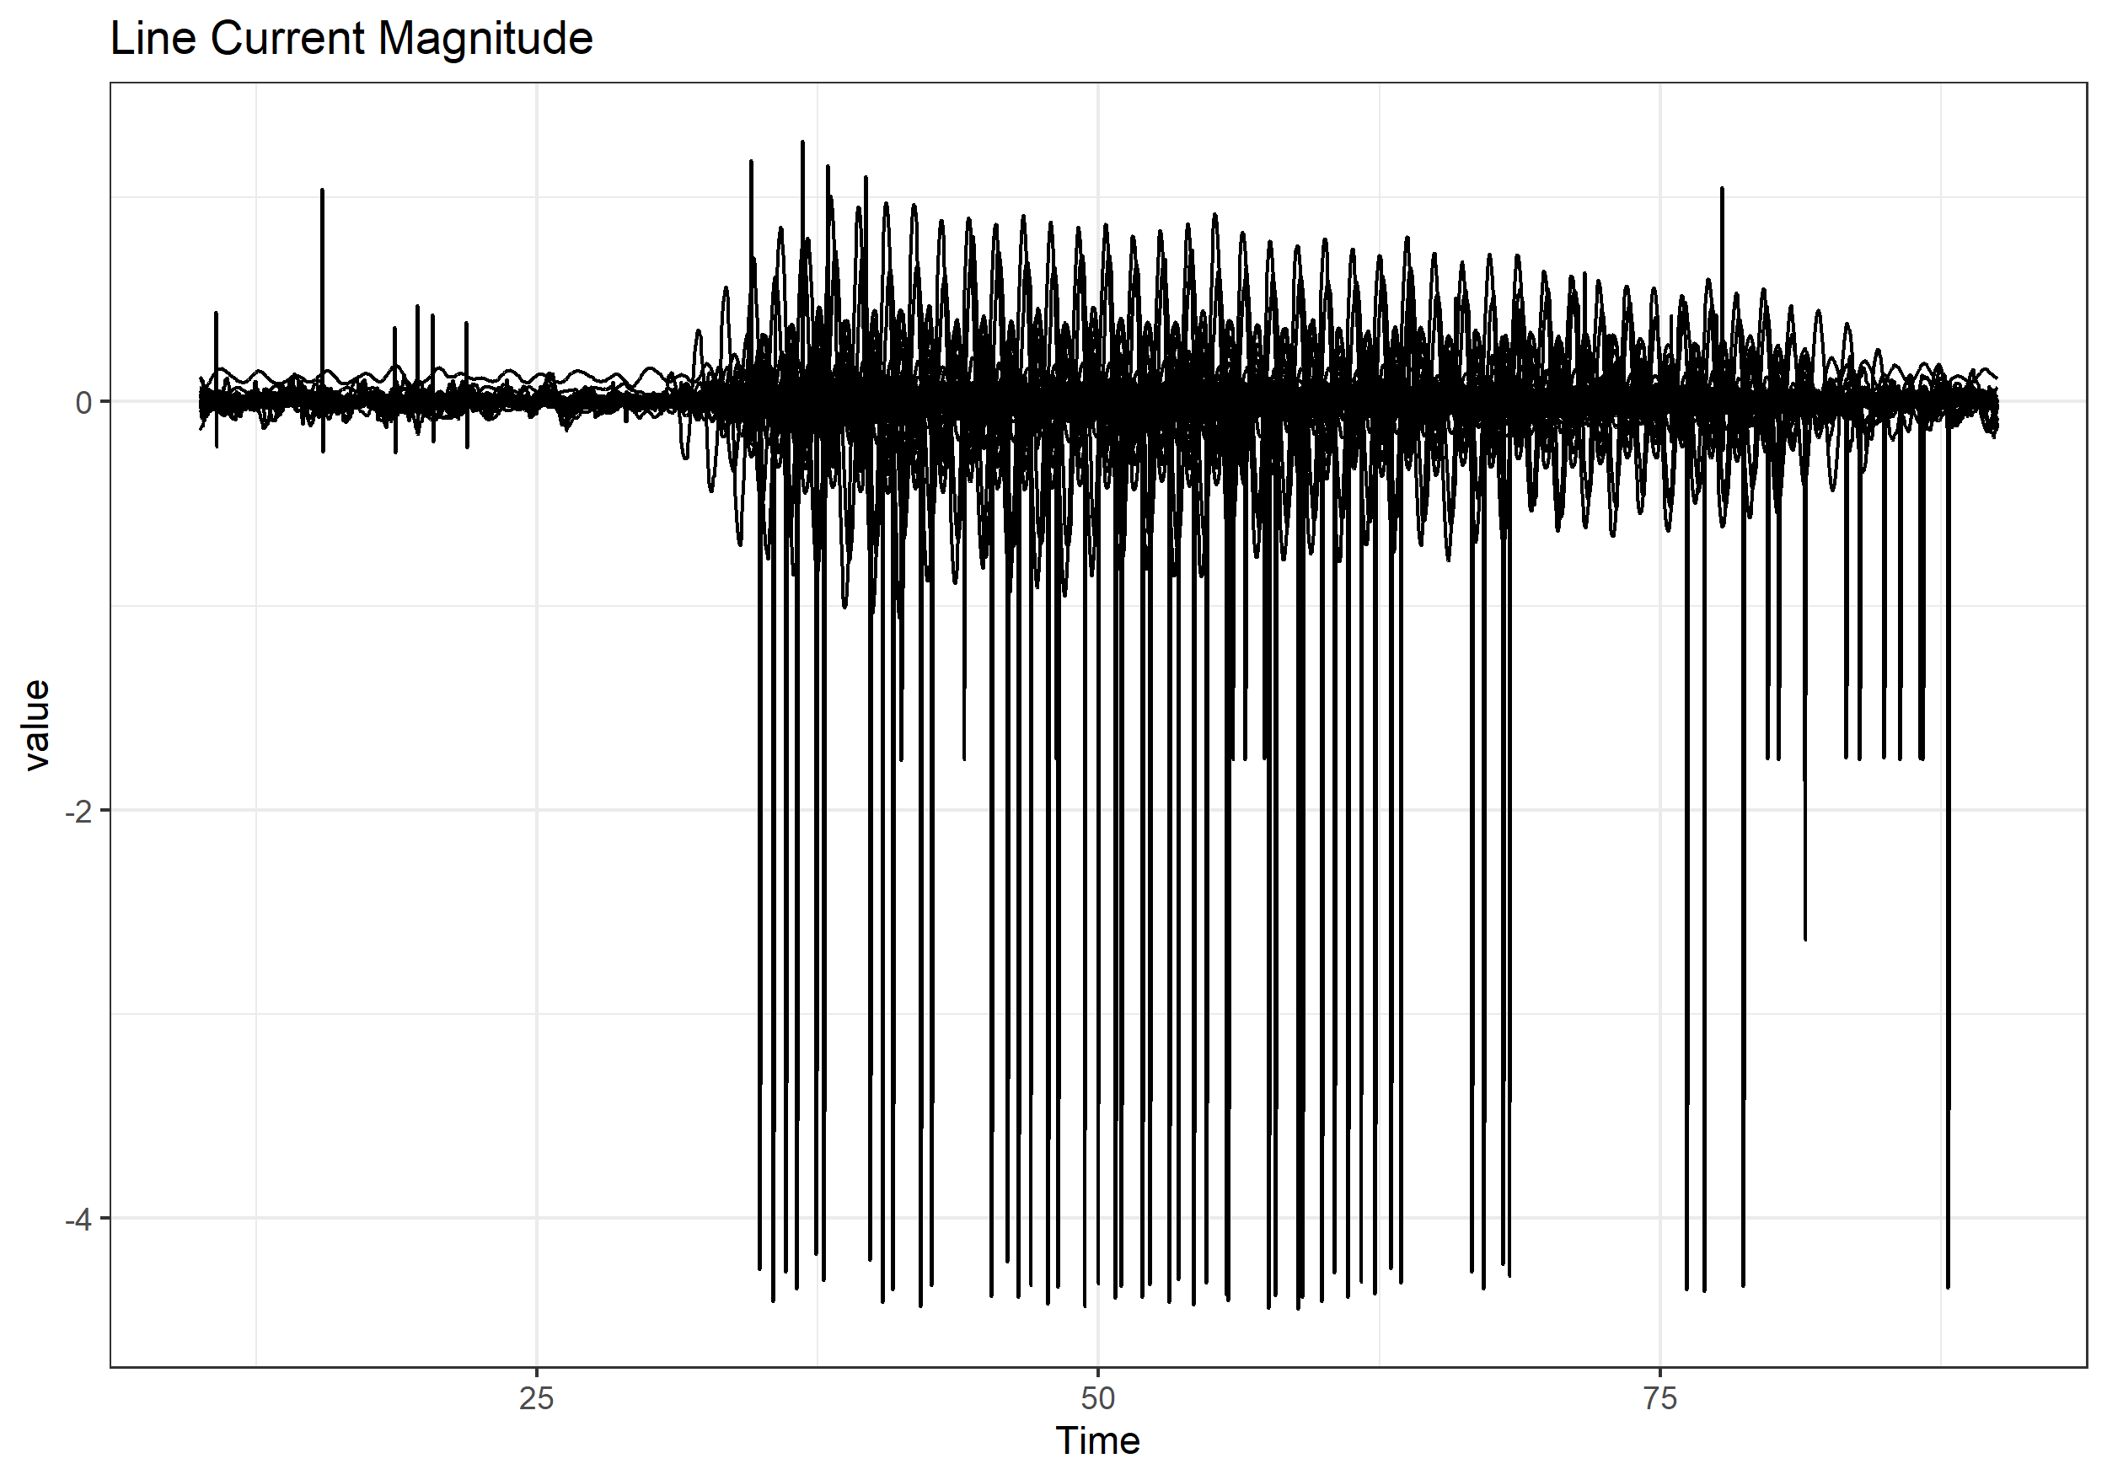
Bus Voltage Magnitude Was Best

Slide 6
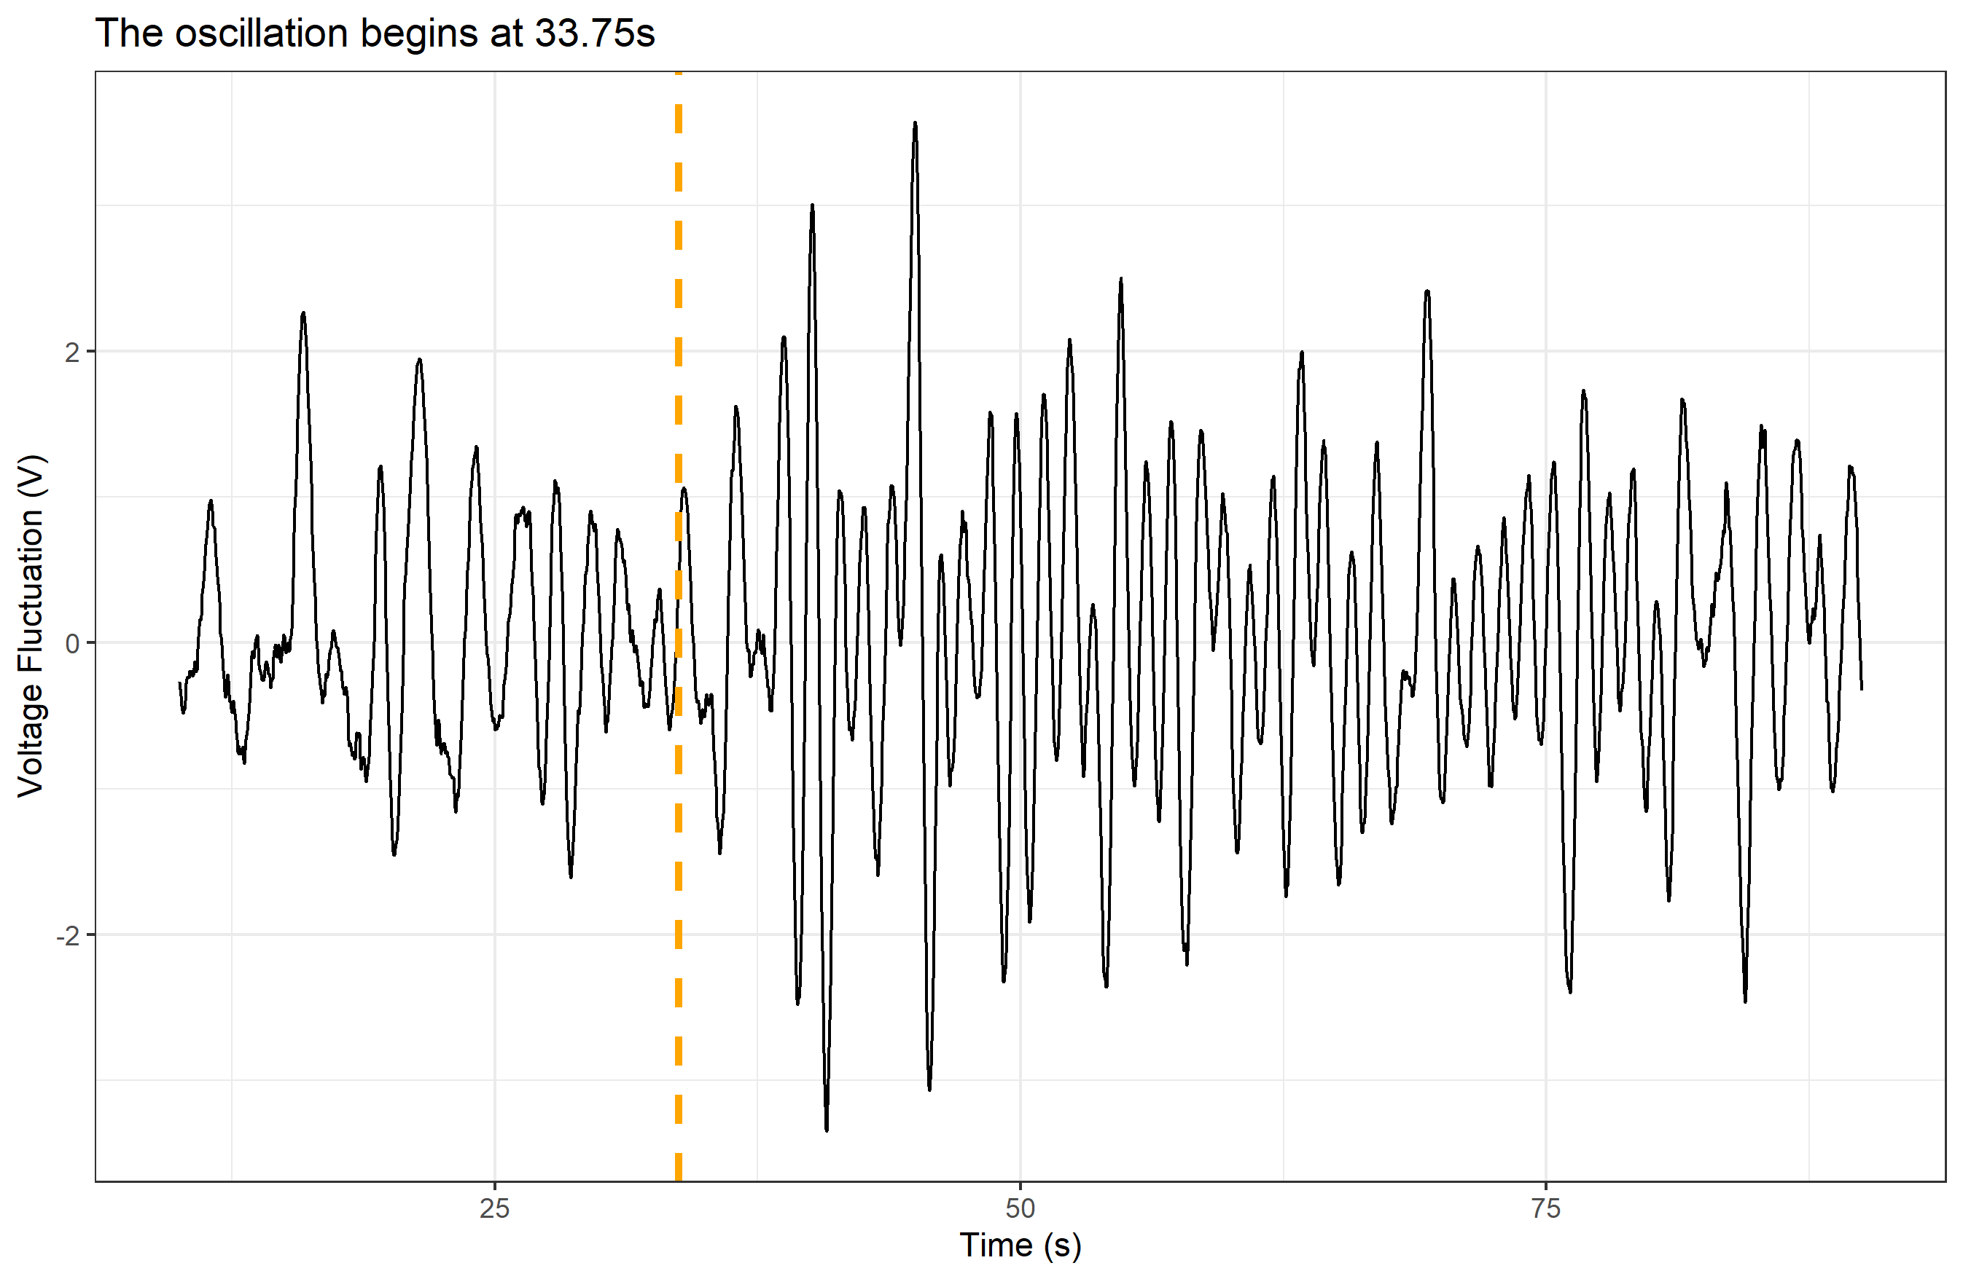
My Plan
Classification through Regression
Mark Case 1 columns with timestamps
(Visual Inspection)
Build 1D-CNN model
Train model on Case 1 data
Apply model to cases 2 – 13
Mark lowest timestamp in each case as oscillation origin

Slide 7
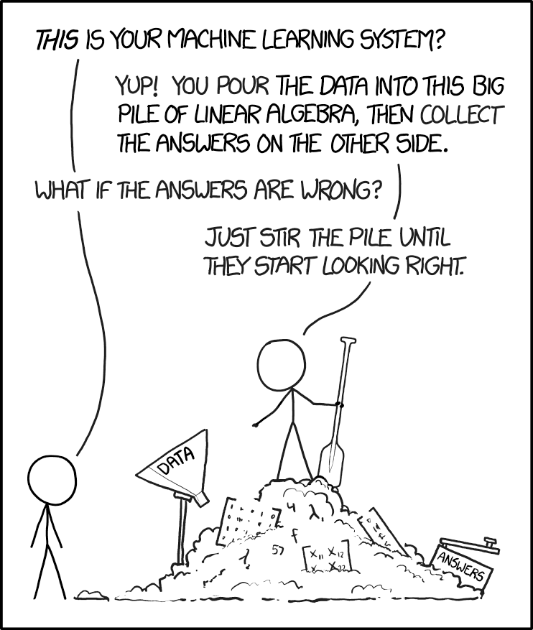
Convolutional Neural Networks (CNNs)
Dense Neural Networks: Recognize specific full sequences
CNNs: Recognize patterns in space/time
2DCNNs: Images
1DCNNs: Time-series
https://xkcd.com/1838/

Slide 8
My Tools
IDE: RStudio
Languages: R 4.1, Python 3.7
Libraries:
Pacman (manage libraries)
Tidyverse (data wrangling and visualization)
TensorFlow/Keras/KerasTuneR (neural networks)
Reticulate (Python integration)

Slide 9
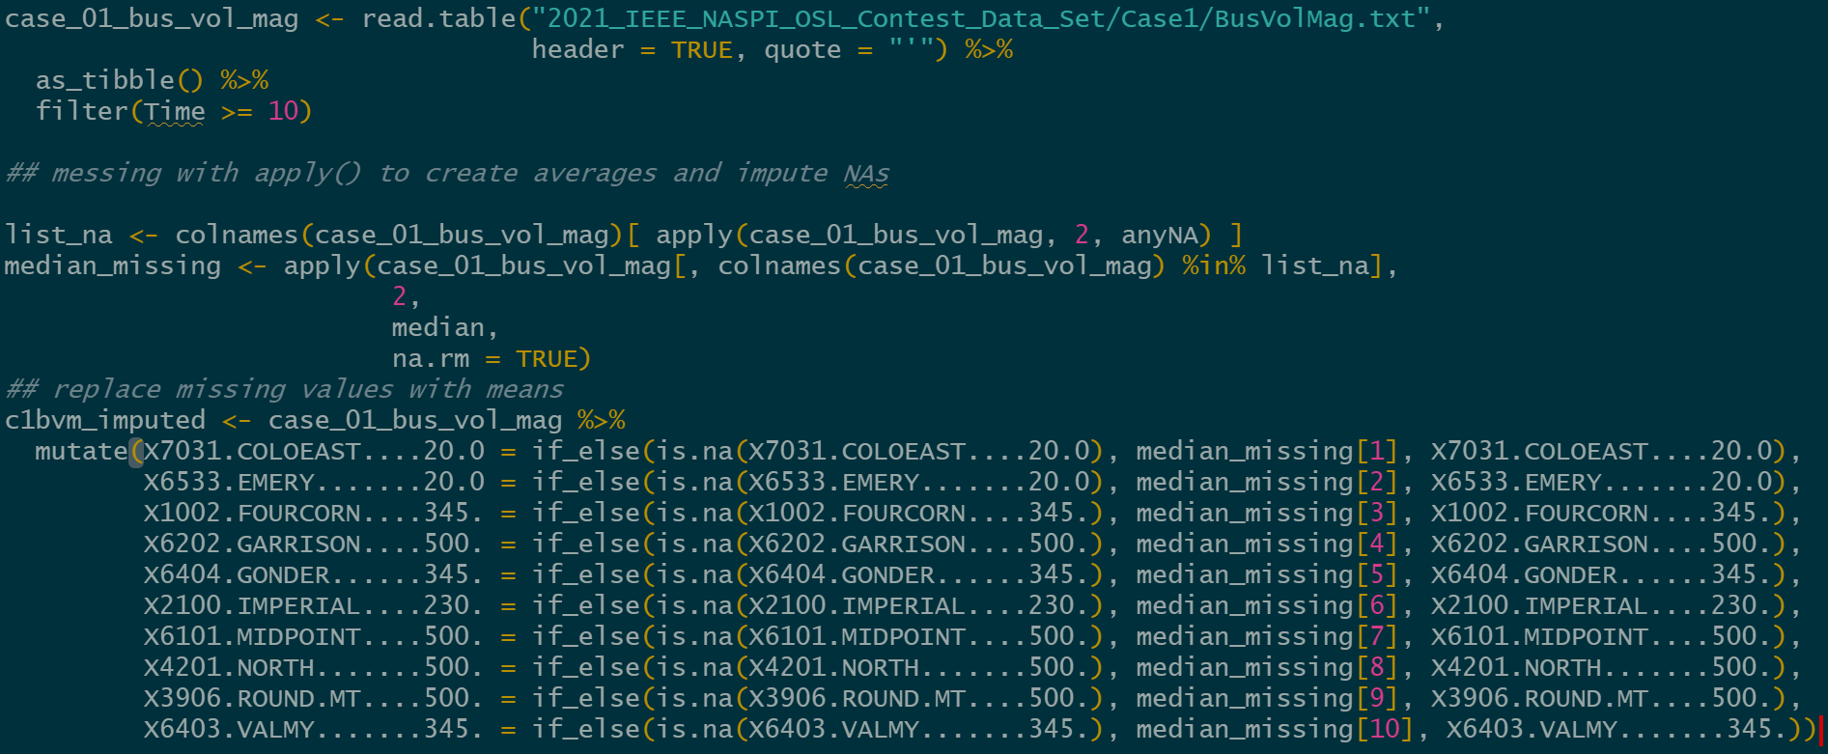
The Data
Data provided in ‘table’ text format
Shape
Time in s, 2701 1/30s increments
58 buses monitored
Cleaning
Remove 1st 10s of data (startup artifacts)
Impute median over NA values
Normalize data

Slide 10
The Network
Split data and labels into train and test groups
Reshape data and labels for 1DCNN
Create, tune, and fit model to data and labels
Evaluate model on test data
Use model to make predictions from other data
1DCNN Input Layer
MaxPooling1D Layer
1DCNN Layer
MaxPooling1D Layer
1DCNN Layer
MaxPooling1D Layer
Flatten Layer
Dense Layer
Dense Output Layer
Loss: 6.98 | MAE: 1.99

Slide 11
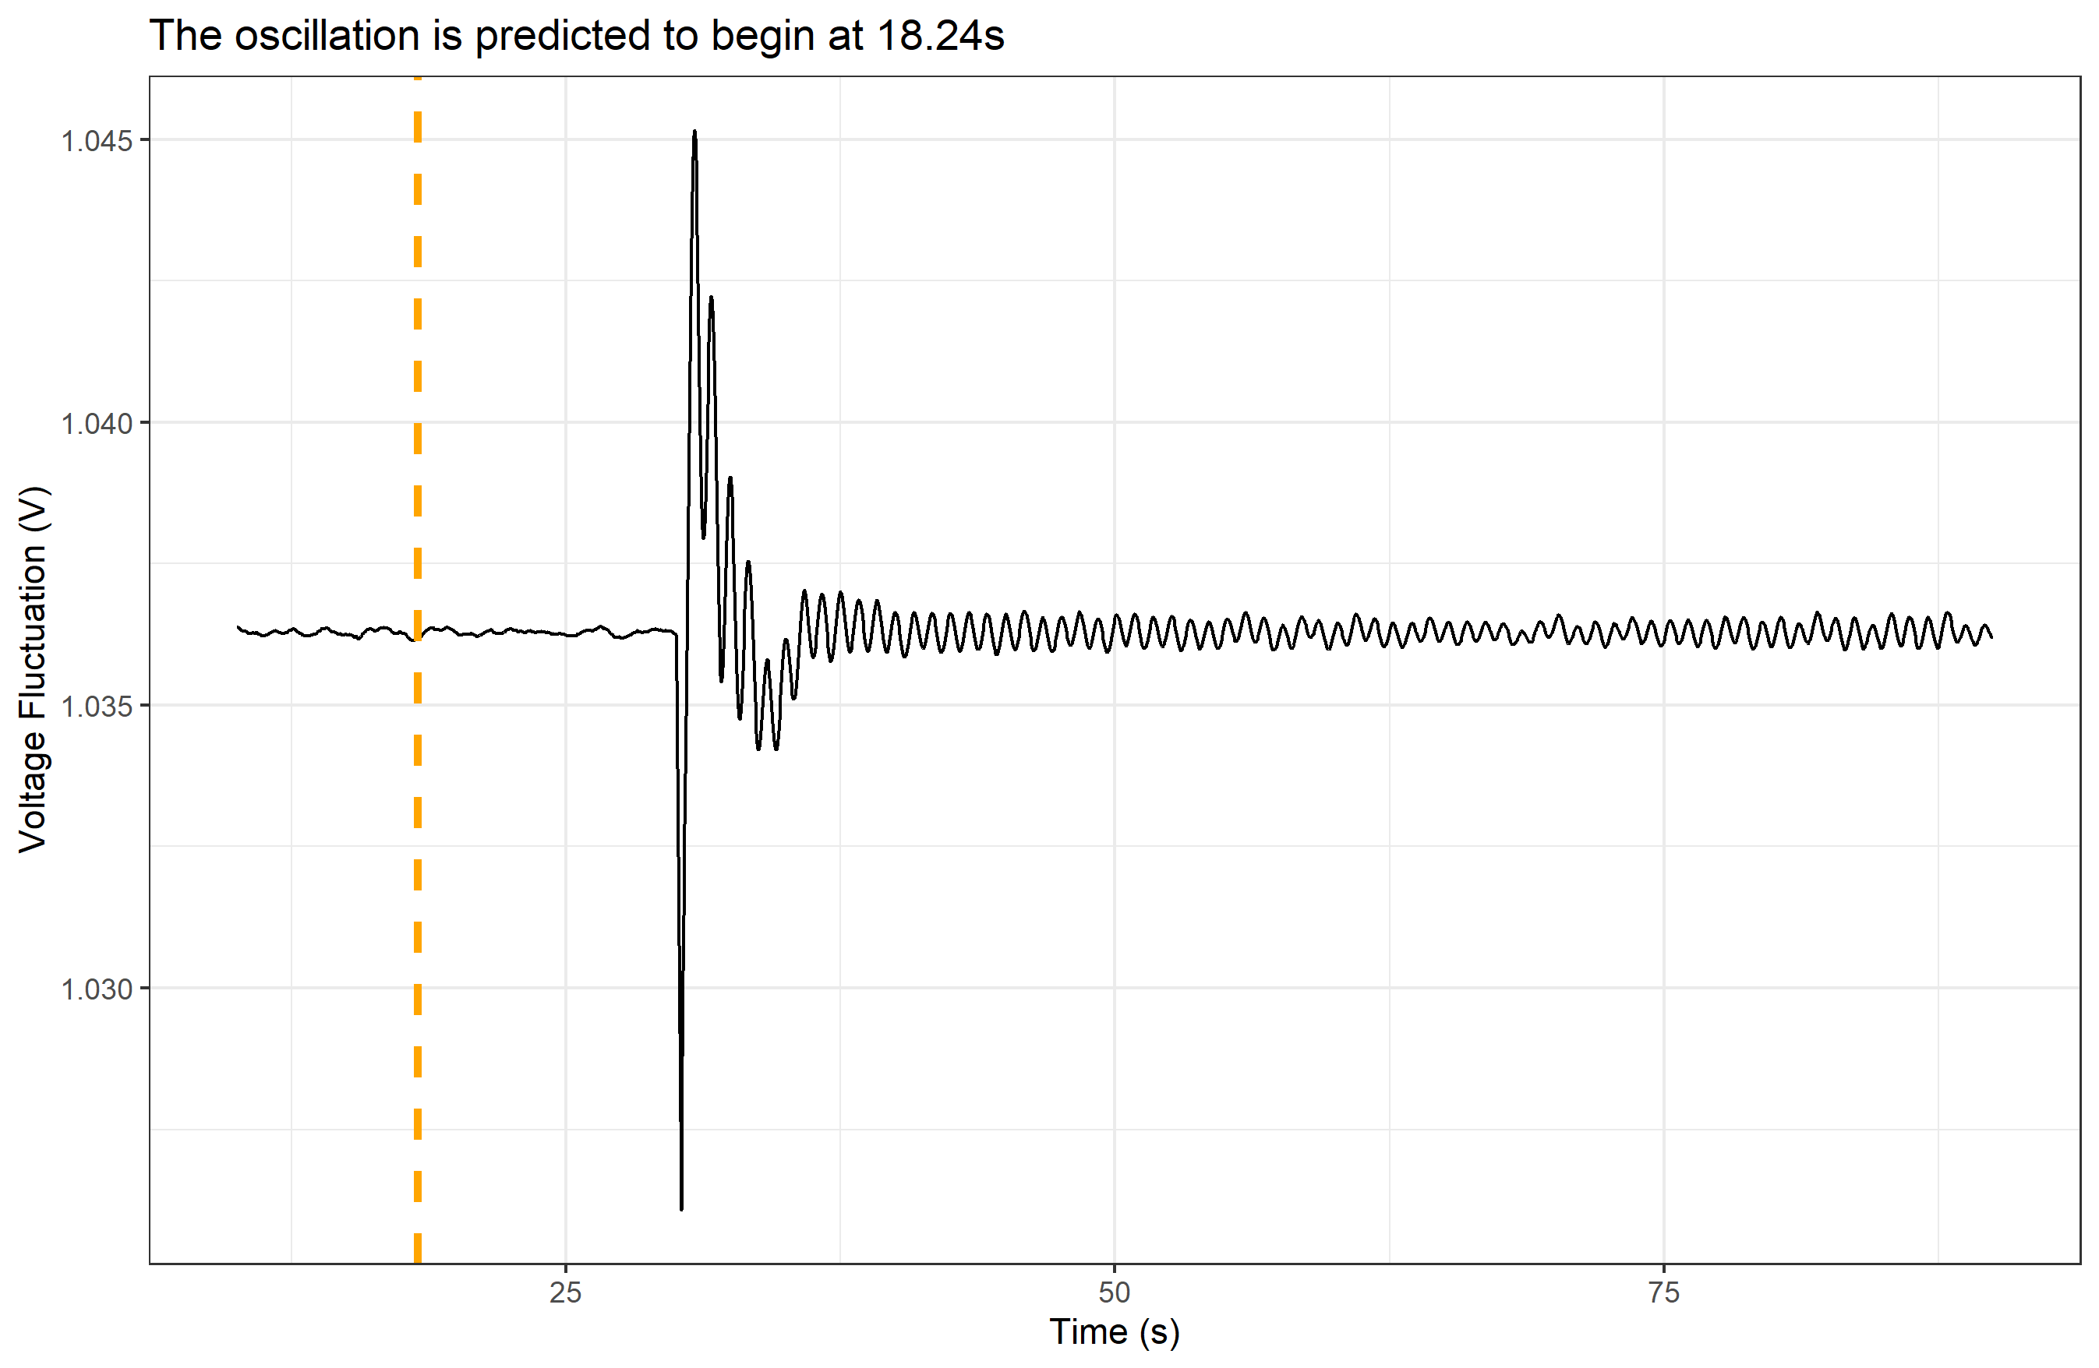
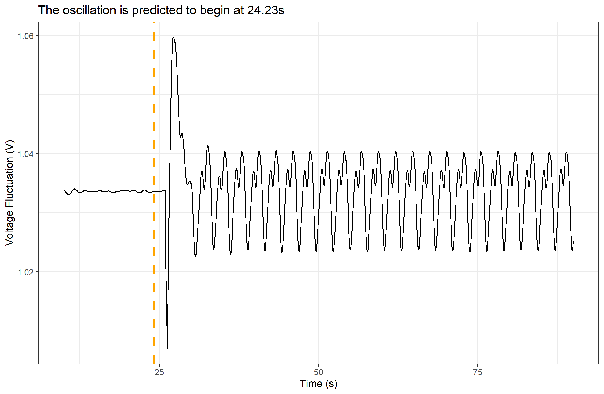
Results
Case | Bus
c01 | X1431.PALOVRD2....20.0
c02 | X1403.PARKER......230.
c03 | X2202.MIGUEL......230.
c04 | X6301.BRIDGER.....345.
c05 | X4101.COULEE......500.
c06 | X6404.GONDER......345.
c07 | X2202.MIGUEL......230.
c08 | X6301.BRIDGER.....345.
c09 | X1403.PARKER......230.
c10 | X1403.PARKER......230.
c11 | X4009.BIG.EDDY....230.
c12 | X6333.BRIDGER.....20.0
c13 | X2619.SYLMARLA....230.

